Slide 1
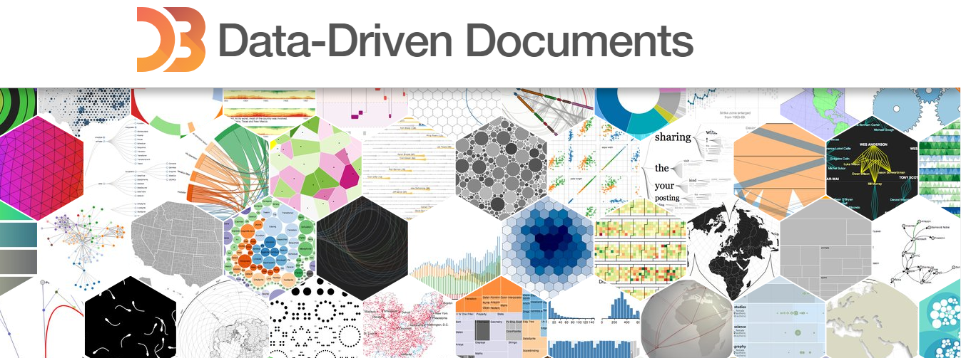
Self Learning Presentation
By: Caffeine Overflow

Slide 2
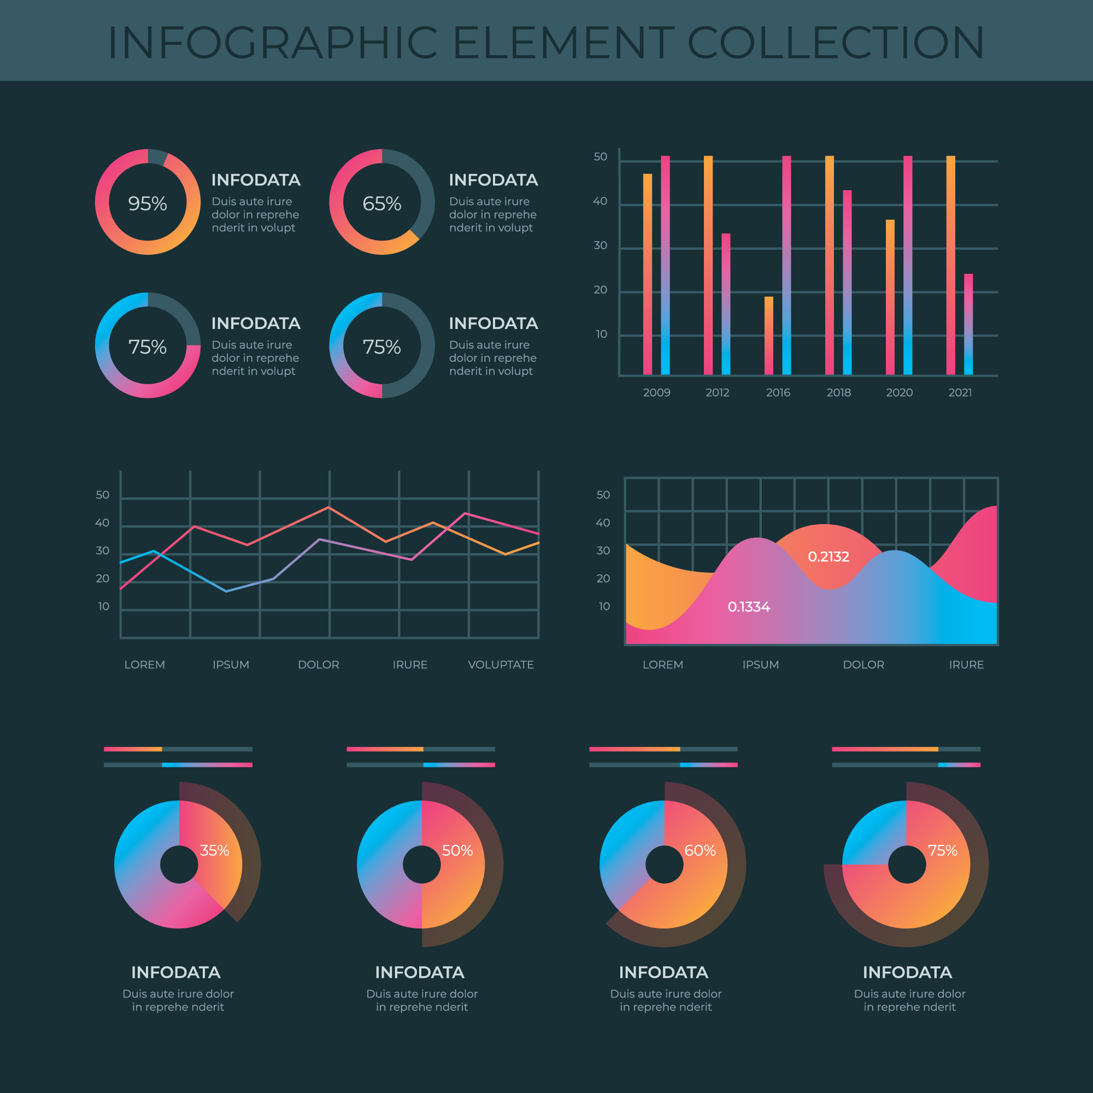
Introduction to D3.js
What is D3.js?
The D3 library enables the transformation of raw data into a large variety of different visualizations.
D3 emphasizes the use of web standards to make it fully capable on most systems.
Why is it important?
In today's world, everything is driven by data.
D3 allows for in-depth and smart analysis of data using visualizations to make it easier to understand.
Through visualizations, D3 allows for easier pattern recognition and allows for identification of trends and outliers within large datasets.
Why did we choose D3.js?
We chose D3 as our research topic as our project heavily revolves around it.

Slide 3
Agenda
1. Overview of data visualization
2. Deeper look into D3.js library
3. Supporting libraries and software
4. Information of how we will be utilizing D3 in our project

Slide 4

Data Visualization Overview
Data visualization is important to better understand our data.
Helps recognize relationships in data
Determine trends over time and predict future trends
Understand frequency at which data is generated
Examine sources of data and helps isolate unwanted data
Overall quicker analysis of large data sets

Slide 5
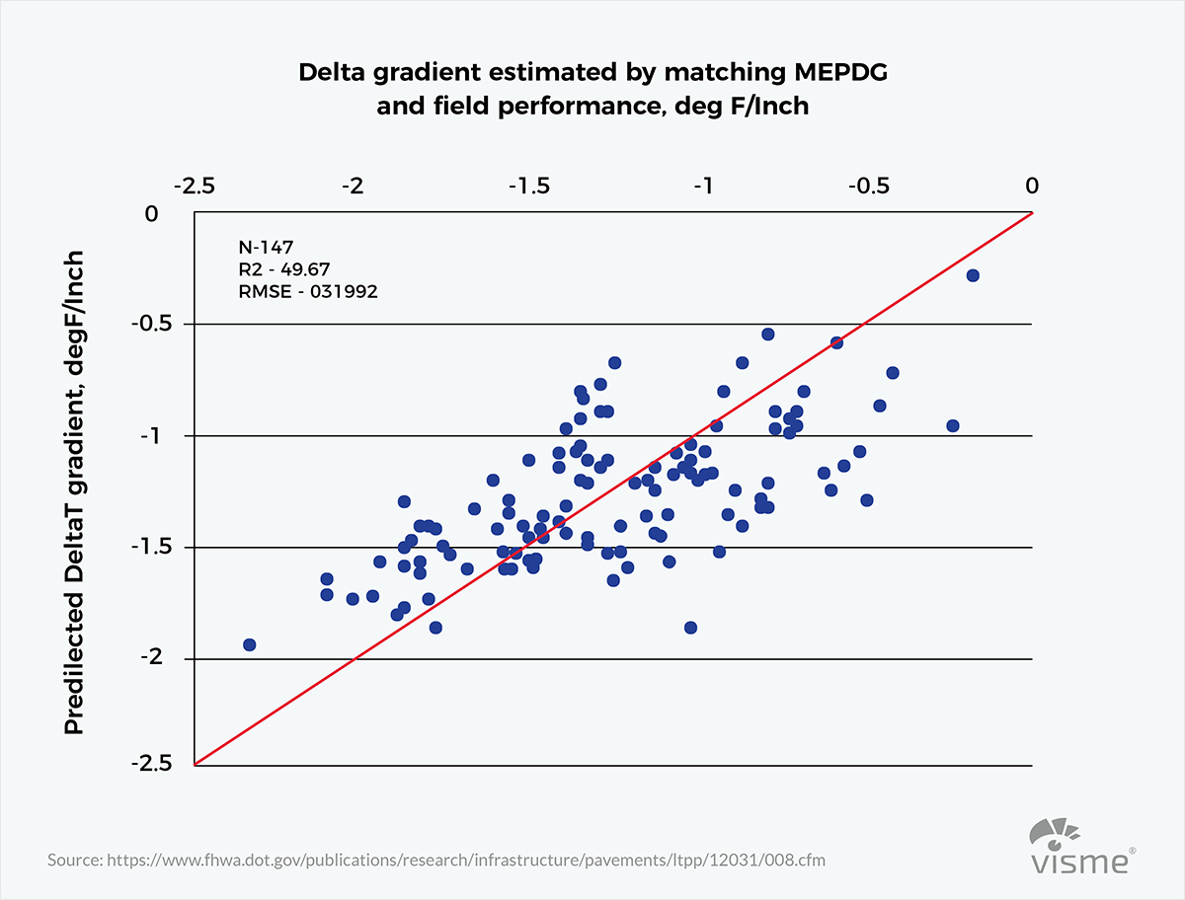
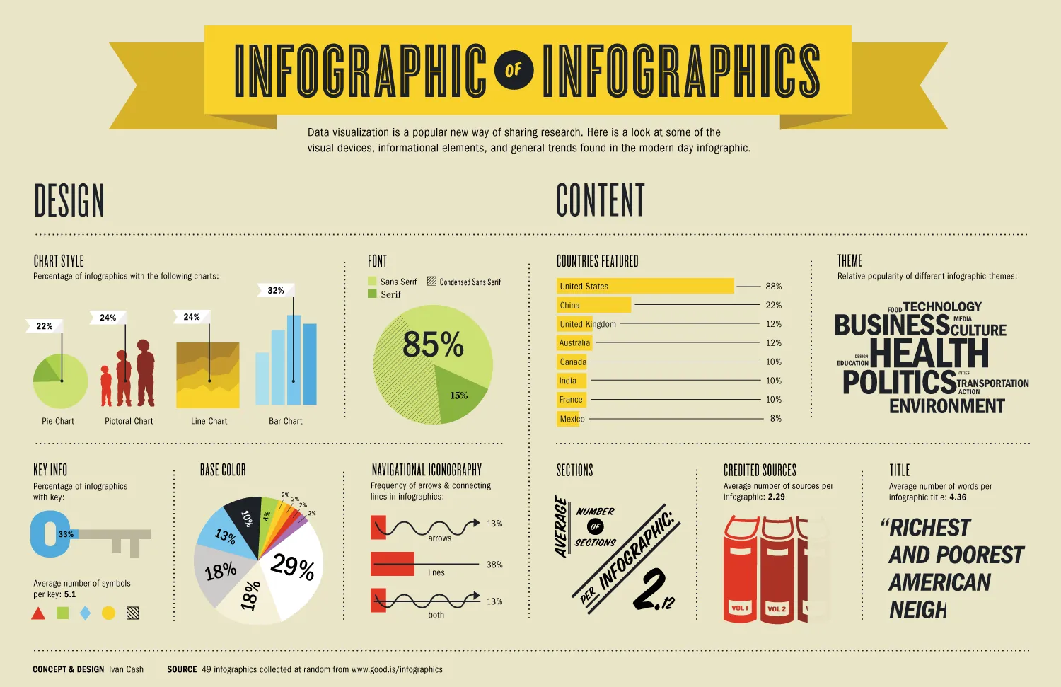
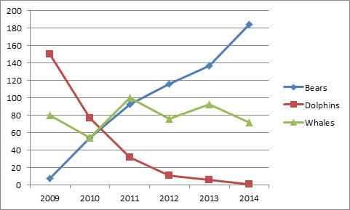
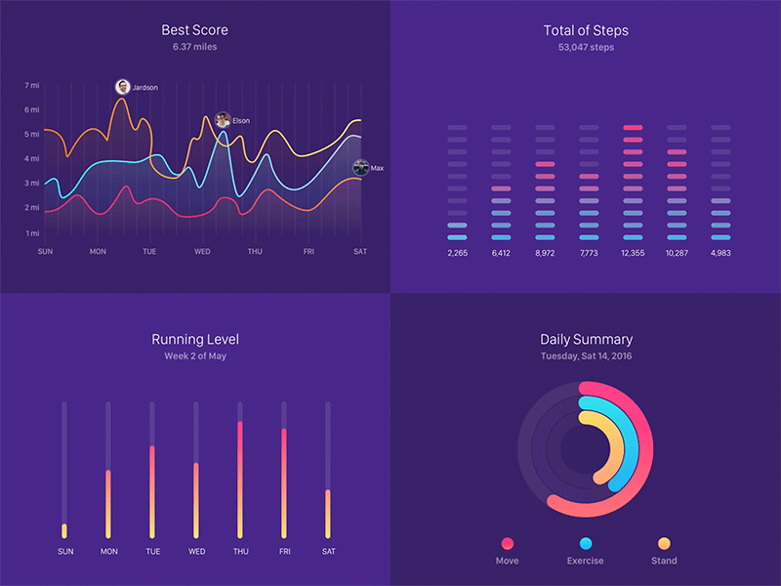
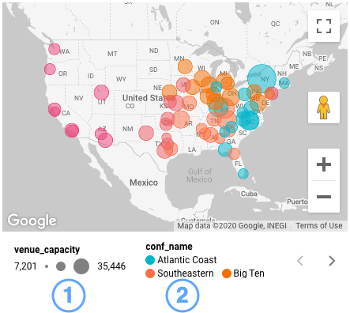
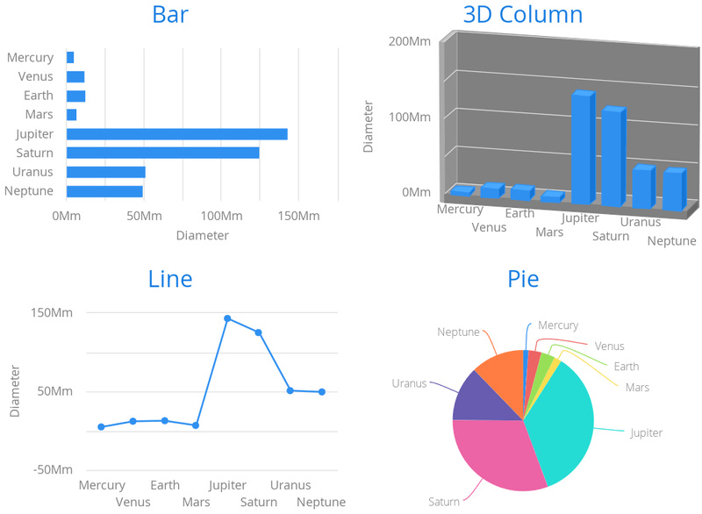
Most Common Data Visualization Techniques
Graphs
Infographics
Graphs
Dashboards
Charts
Geo Maps

Slide 6
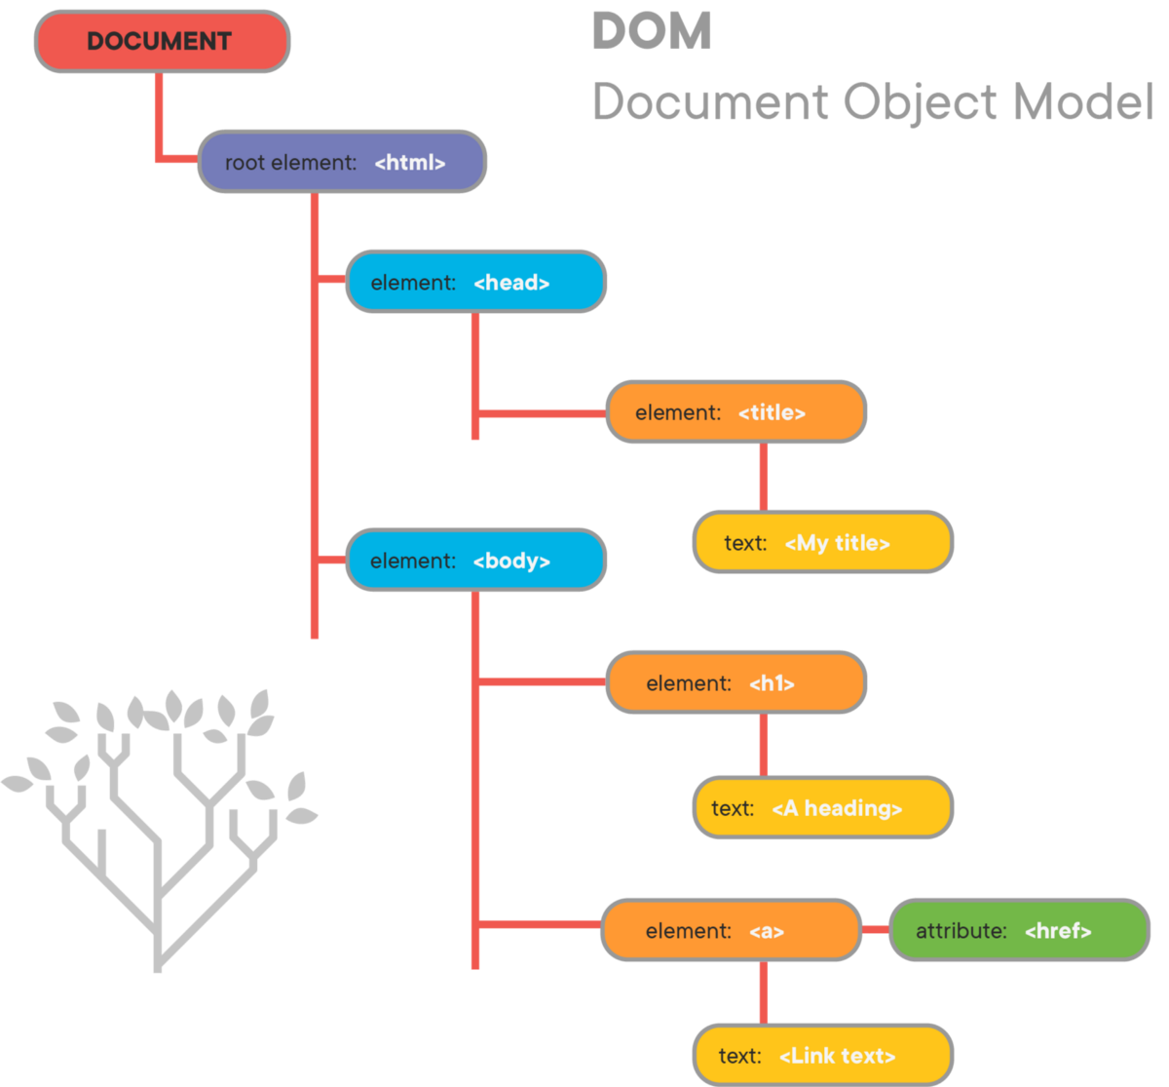
D3.js (How it Works)
Bind unfiltered raw data to a Document Object Model (DOM)
A DOM -> API interface for HTML and XML documents
Allows for definition of logical structure for documents used for data manipulation
Used to create and apply transformations to the document

Slide 7

D3.js (How it Works Cont'd)
Most data analysis software have limited ways to represent data
D3 on the other hand does not come with built in ways to represent data.
D3 helps data fully interact with HTML, SVG, and CSS.
Implements helper functions and generate variables to use for visualizations of data.
Gives full control of customizability to user
D3 itself does not come with built-in visualizations however there are many user-created templates available for use.

Slide 8

D3.js (Downsides)
D3 is not the best option for simple data visualizations like charts or graphs as there are easier alternatives.
D3 has a very high learning curve
Requires a high-level understanding of web programming concepts
Understanding of programming languages like JavaScript and SVG(Scalable Vector Graphics)

Slide 9

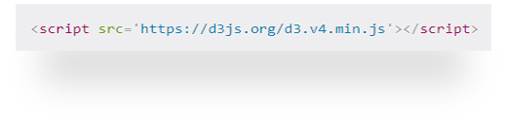

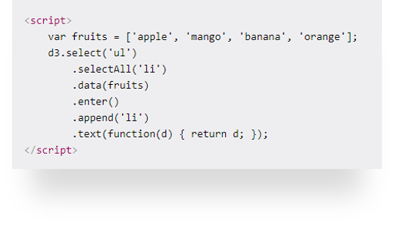
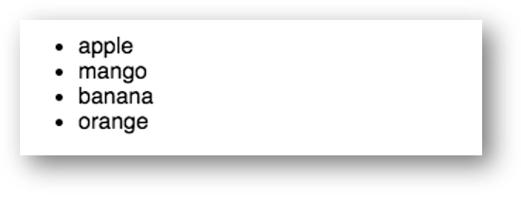
D3.js (Operation)
To start, we must include the D3 library by using a script tag
We then bind the data to a Document Object Model which we can later apply transformations to
We can then append the data into the HTML elementsements

Slide 10
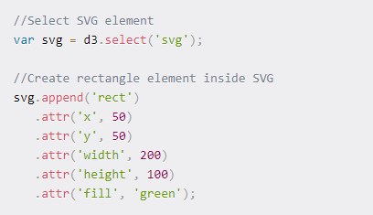

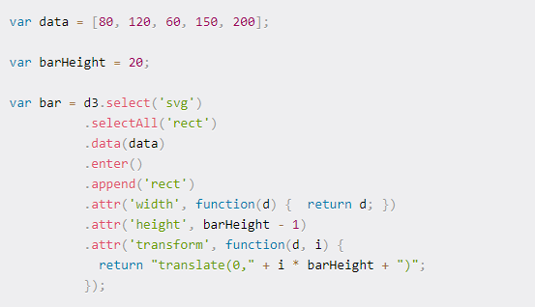

D3.js (Operation Cont'd)
Creating a simple bar chart
First, we create the SVG element so in this case, a rectangle
Then we can use D3 functions to create and render the bar chart

Slide 11

Examples

Slide 12

Relevance
We are building a data analytics tool using D3.js
The goal:
User uploads raw data
The website automatically determines the most applicable visualizations based on the data types provided by the user
The data is uploaded into a MongoDB database which feeds D3 to generate the visualizations

Slide 13

Thanks for Listening
We hope you enjoyed and learned something new!
Any questions?

